Slide 1
Vehicle Parking Management System
Team Members:
D Bheemeshwar – 25RBAID0029
Y Akhil – 25RBAID0027
O Sheshanth – 25RBAID0022
G Manikanta – 25RBAIM0073
R Santhosh – 25RAIM0076
M Bhupal – 25RBAIM0068

Slide 2
Problem Statement:
Manual parking causes long queues and inaccurate slot tracking during peak hours. ​Underutilized lots Drivers waste time circling for spaces, leading to congestion.​ Billing errors and missing logs create disputes and security gaps. Automation via RFID, real-time allocation, and payments is essential.
Objective: Automate parking operations with RFID/camera entry, slot allocation, payments, and reports for 500+ slots.

Slide 3
1. Requirement Phase
Identify user needs
Parking slot tracking, vehicle entry/exit logs
Payment handling and reports
Overbooking prevention

Slide 4
2. Design Phase
SYSTEM ARCHITECTURE :
Sensors and cameras: Captures the vehicles and Send data to the central server.
Central Server : This is brain of the system.
Database(MYSQL): Stores the data.
Payment Gateway: UPI, QR code, cards and sends transaction status back to the server.
Data Flow: It is the Step-by-Step Flow which Entry process and exit process.
UI WIREFRAMES:
Home Screen: Slot map (Green=Free, Red=Occupied).
Login/Signup: Phone/OTP auth.
Main Screen: Entry scan, payment QR.
Settings: Profile, history.

Slide 5
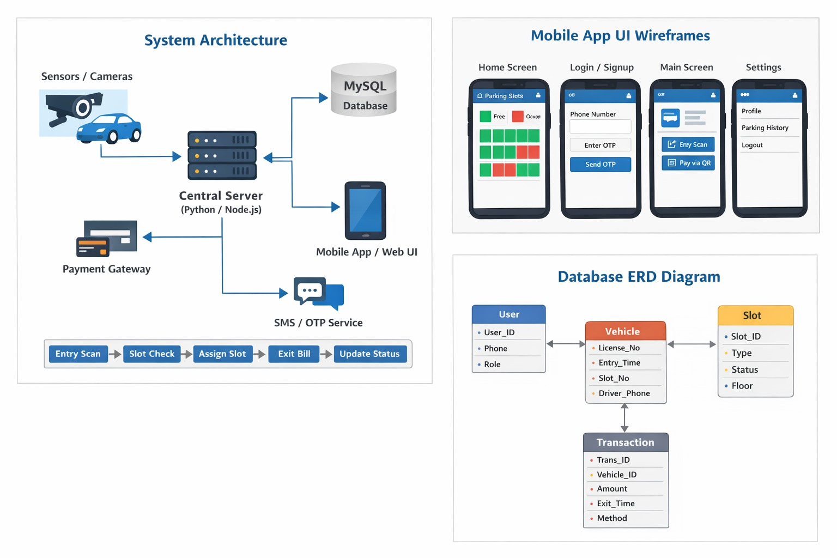
.

Slide 6
3. Development Phase
Code written based on design
Modules developed:
- Vehicle entry module.
-Slot management module.
- Payment module.
Code Walkthrough Notes:
Implemented: Entry logic, DB connections.
Blockers: Camera API latency.
Next Steps: Test integration, add notifications.
Deliverable: Updated Backlog, Feature Demo

Slide 7
4. Testing Phase
I tested a Vehicle Parking Management System.
This system helps us when vehicles come, find an empty slot, pay the fee, and leave.
During testing, I checked:
Can the system give a parking slot correctly?
Does payment work and send a receipt?
Does the system stop vehicles when parking is full?
Is the exit time and slot release correct?

Slide 8
5. Deployment Phase
System installed for real use
Staff trained to operate system
Parking area starts using software
Deployment Checklist:
Code merged to main
DB configured (500 slots seeded)
Env vars set (API keys)
Build successful
Final tests passed
Version tagged v1.0

Slide 9
6. Maintenance Phase
Vehicle parking management system means the activities done after the system is deployed to keep it working smoothly
Updating features
Improving performance
Improve slot display UI
fixing bugs
Regularly check parking sensors,cameras,and entry/exit gates

Slide 10
Conclusion
SDLC helps build a reliable parking management system
Each phase improves planning
System is useful for malls, offices, and parking areas

